Slide 1
Contents
Introduction
Update Anomalies
Normalization
1NF

Slide 2
Introduction to Normalization
The normalization process, as first proposed by Codd (1972a), takes a relation schema through a series of tests to certify whether it satisfies a certain normal form.
Normalization is the process of organizing the data in the database.
Normalization is used to minimize the redundancy from a relation or set of relations. It is also used to eliminate the undesirable characteristics like Insertion, Update and Deletion Anomalies.
Normalization divides the larger table into the smaller table and links them using relationship.
The normal form is used to reduce redundancy from the database table.

Slide 3
Introduction to Normalization
There are the five types of normal forms:
Normal Form | Description
1NF | A relation is in 1NF if it contains an atomic value.
2NF | A relation will be in 2NF if it is in 1NF and all non-key attributes are fully functional dependent on the primary key.
3NF | A relation will be in 3NF if it is in 2NF and no transition dependency exists.
4NF | A relation will be in 4NF if it is in Boyce Codd normal form and has no multi-valued dependency.
5NF | A relation is in 5NF if it is in 4NF and not contains any join dependency and joining should be lossless.

Slide 4
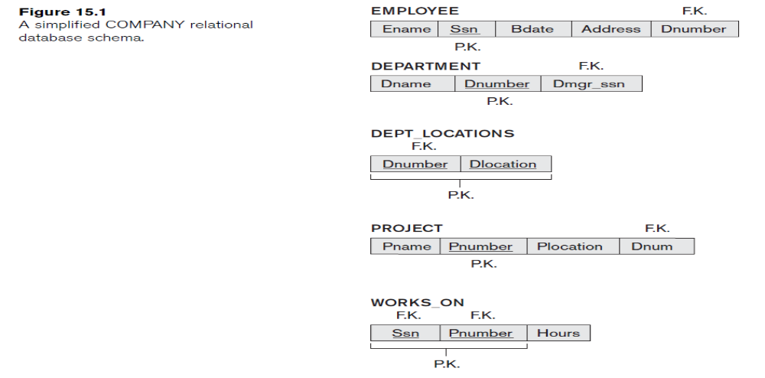
Introduction to Normalization
Consider the following database schema:

Slide 5
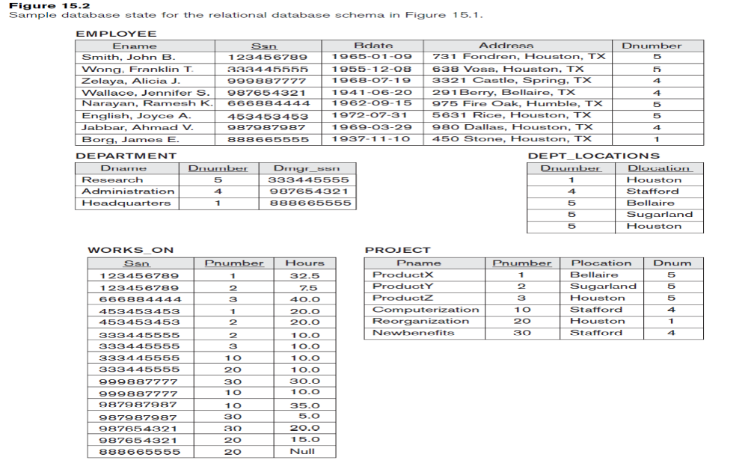
Introduction to Normalization
Consider the following database schema:

Slide 6
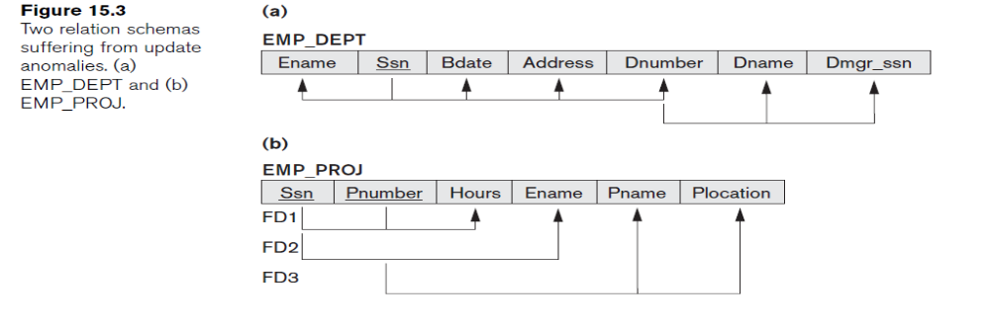
Introduction to Normalization
Applying Natural Join on :
Employee and department(EMP_DEPT relation schema in Figure 15.3(a) represents a single employee with the name (Dname) of the department for which the employee works and the Social Security number (Dmgr_ssn) of the department manager.)
Employee and Project (For the EMP_PROJ relation in Figure 15.3(b), each tuple relates an employee to a project but also includes the employee name (Ename), project name (Pname), and project location (Plocation).)

Slide 7
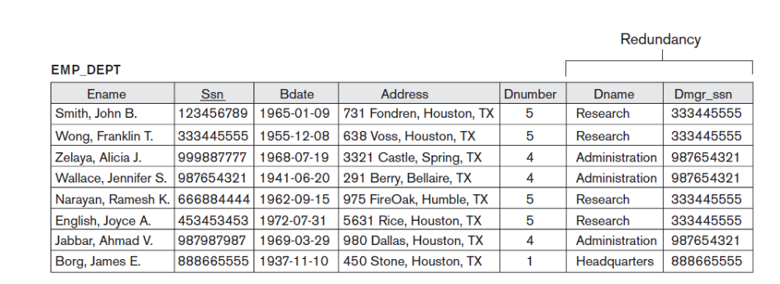
Introduction to Normalization
Applying Natural Join on Employee and department:

Slide 8
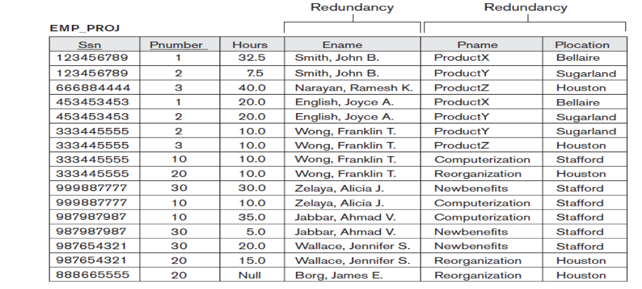
Introduction to Normalization
Applying Natural Join on Employee and Project using Works on relation

Slide 9
Update Anomalies
Storing natural joins of base relations leads to an additional problem referred to as update anomalies.
These can be classified into:
1.Insertion anomalies
2.Deletion anomalies
3.Modification anomalies

Slide 10
Insertion Anomalies
Insertion anomalies can be differentiated into two types, illustrated by the following examples based on the EMP_DEPT relation:
1. To insert a new employee tuple into EMP_DEPT, we must include either the attribute values for the department that the employee works for, or NULLs (if the employee does not work for a department as yet).
2. It is difficult to insert a new department that has no employees as yet in the EMP_DEPT relation. The only way to do this is to place NULL values in the attributes for employee. This violates the entity integrity for EMP_DEPT because SSN is its primary key.

Slide 11
Deletion Anomalies
Deletion Anomalies. The problem of deletion anomalies is related to the second insertion anomaly situation just discussed. If we delete from EMP_DEPT an employee tuple that happens to represent the last employee working for a particular department, the information concerning that department is lost from the database.
This problem does not occur in the database without using Natural Join where DEPARTMENT tuples are stored separately.

Slide 12
Modification Anomalies
Modification Anomalies. In EMP_DEPT, if we change the value of one of the attributes of a particular department—say, the manager of department 5—we must update the tuples of all employees who work in that department; otherwise, the database will become inconsistent. If we fail to update some tuples, the same department will be shown to have two different values for manager in different employee tuples, which would be wrong.

Slide 13
Normal Forms Based on Primary Keys
Definitions of Keys and Attributes Participating in Keys
A superkey of a relation schema R = {A1, A2, ... , An} is a set of attributes
S ⊆ R with the property that no two tuples t1 and t2 in any legal relation state r of R will have t1[S] = t2[S].
A key K is a superkey with the additional property that removal of any attribute from K will cause K not to be a superkey anymore.
The difference between a key and a superkey is that a key has to be minimal; that is, if we have a key K = {A1, A2, ..., Ak} of R, then K – {Ai} is not a key of R for any Ai, 1 ≤ i ≤ k.

Slide 14
Normal Forms Based on Primary Keys
Definitions of Keys and Attributes Participating in Keys
{Ssn} is a key for EMPLOYEE, whereas {Ssn}, {Ssn, Ename}, {Ssn, Ename, Bdate}, and any set of attributes that includes Ssn are all superkeys.

Slide 15
Normal Forms Based on Primary Keys
Definitions of Keys and Attributes Participating in Keys
. If a relation schema has more than one key, each is called a candidate key. One of the candidate keys is arbitrarily designated to be the primary key, and the others are called secondary keys.
In the previous schema
{Ssn} is the only candidate key for EMPLOYEE, so it is also the primary key.
An attribute of relation schema R is called a prime attribute of R if it is a member of some candidate key of R. An attribute is called nonprime if it is not a prime attribute—that is, if it is not a member of any candidate key.
In previous schema, both Ssn and Pnumber are prime attributes of WORKS_ON, whereas other attributes of WORKS_ON are nonprime.

Slide 16
First Normal Form
First normal form (1NF) states that the domain of an attribute must include only atomic (simple, indivisible) values and that the value of any attribute in a tuple must be a single value from the domain of that attribute.
Hence, 1NF disallows having a set of values, a tuple of values, or a combination of both as an attribute value for a single tuple.

Slide 17
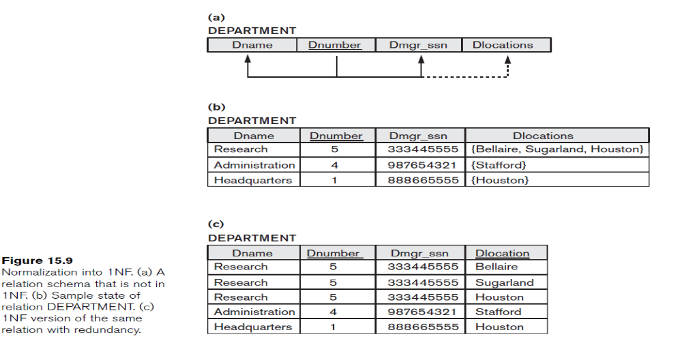
First Normal Form
Consider the DEPARTMENT relation schema shown in Figure 15.1, whose primary key is Dnumber, and suppose that we extend it by including the Dlocations attribute as shown in Figure 15.9(a). We assume that each department can have a number of locations. The DEPARTMENT schema and a sample relation state are shown in Figure 15.9. As we can see, this is not in 1NF because Dlocations is not an atomic attribute, as illustrated by the first tuple in Figure 15.9(b).

Slide 18

First Normal Form
There are three main techniques to achieve first normal form for such a relation:
Remove the attribute Dlocations that violates 1NF and place it in a separate relation DEPT_LOCATIONS along with the primary key Dnumber of DEPARTMENT.
Expand the key so that there will be a separate tuple in the original DEPARTMENT relation for each location of a DEPARTMENT, as shown in Figure 15.9(c). In this case, the primary key becomes the combination {Dnumber, Dlocation}. This solution has the disadvantage of introducing redundancy in the relation.
If a maximum number of values is known for the attribute—for example, if it is known that at most three locations can exist for a department—replace the Dlocations attribute by three atomic attributes: Dlocation1, Dlocation2, and Dlocation3. This solution has the disadvantage of introducing NULL values if most departments have fewer than three locations.

Slide 19
Contents
Second Normal Form(2NF)
Third Normal Form(3NF)
Boyce Codd Normal Form(BCNF)

Slide 20
Second Normal Form (2NF)
Second normal form (2NF) is based on the concept of full functional dependency.
A functional dependency X → Y is a full functional dependency if removal of any attribute A from X means that the dependency does not hold any more; that is, for any attribute A ε X, (X – {A}) does not functionally determine Y.
A functional dependency X→Y is a partial dependency if some attribute A ε X can be removed from X and the dependency still holds; that is, for some A ε X, (X – {A}) → Y.

Slide 21
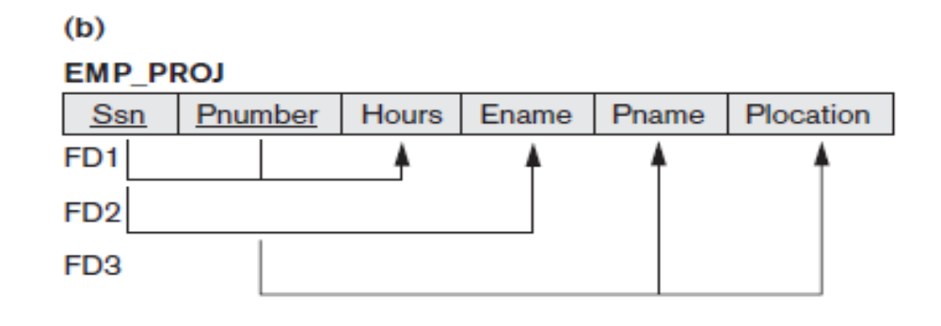
Second Normal Form (2NF)
{Ssn, Pnumber} → Hours is a full dependency
(neither Ssn → Hours nor Pnumber→Hours holds).
The dependency {Ssn, Pnumber}→Ename is partial because Ssn→Ename holds.

Slide 22
Second Normal Form (2NF)
Definition. A relation schema R is in 2NF if every nonprime attribute A in R is fully functionally dependent on the primary key of R.
The test for 2NF involves testing for functional dependencies whose left-hand side attributes are part of the primary key.
If the primary key contains a single attribute, the test need not be applied at all.

Slide 23
Second Normal Form (2NF)
The EMP_PROJ relation in Figure is in 1NF but is not in 2NF.
The nonprime attribute Ename, Pname and Plocation violates 2NF because of FD2 and FD3.
The functional dependencies FD2 and FD3 make Ename, Pname, and Plocation partially dependent on the primary key {Ssn, Pnumber} of EMP_PROJ, thus violating the 2NF test.

Slide 24
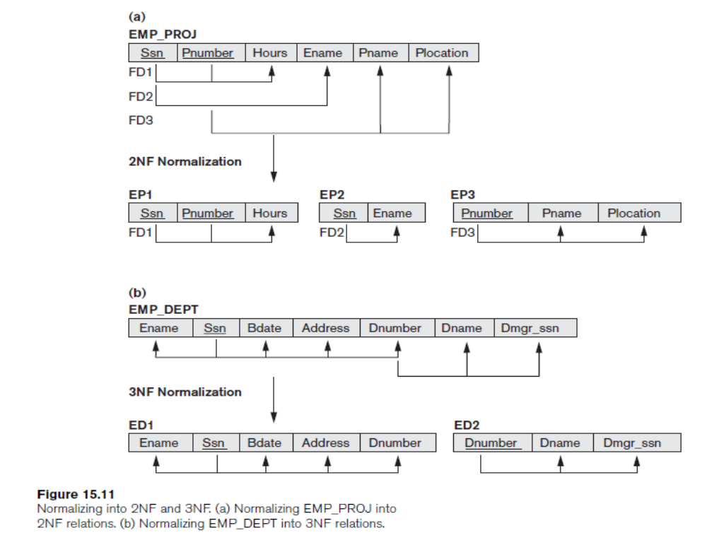
Second Normal Form (2NF)
If a relation schema is not in 2NF, it can be second normalized or 2NF normalized into a number of 2NF relations.
Therefore, the functional dependencies FD1, FD2, and FD3 lead to the decomposition of EMP_PROJ into the three relation schemas EP1, EP2, and EP3 each of which is in 2NF.

Slide 25
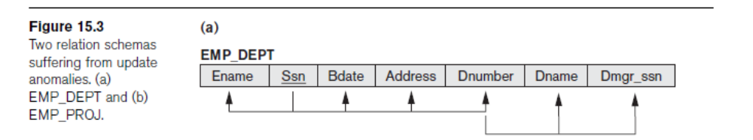
Third Normal Form (3NF)
Third normal form (3NF) is based on the concept of transitive dependency.
A functional dependency X→Y in a relation schema R is a transitive dependency if there exists a set of attributes Z in R that is neither a candidate key nor a subset of any key of R and both X→Z and Z→Y hold.
The dependency Ssn→Dmgr_ssn is transitive through Dnumber in EMP_DEPT because both the dependencies Ssn → Dnumber and Dnumber → Dmgr_ssn hold and Dnumber is neither a key itself nor a subset of the key of EMP_DEPT.
The dependency of Dmgr_ssn on Dnumber is undesirable in EMP_DEPT since Dnumber is not a key of EMP_DEPT.

Slide 26
Third Normal Form (3NF)
Definition. According to Codd’s original definition, a relation schema R is in 3NF if it satisfies 2NF and no nonprime attribute of R is transitively dependent on the primary key.
The relation schema EMP_DEPT is in 2NF, since no partial dependencies on a key exist. However, EMP_DEPT is not in 3NF because of the transitive dependency of Dmgr_ssn (and also Dname) on Ssn via Dnumber.

Slide 27
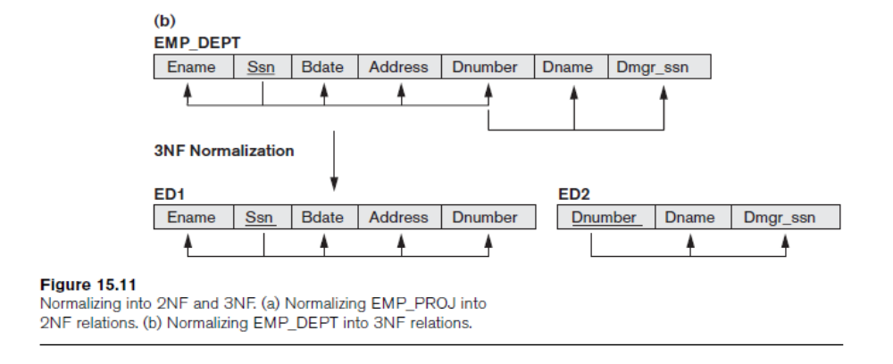
Third Normal Form (3NF)
We can normalize EMP_DEPT by decomposing it into the two 3NF relation schemas ED1 and ED2.
ED1 and ED2 represent independent entity facts about employees and departments. A NATURAL JOIN operation on ED1 and ED2 will recover the original relation EMP_DEPT without generating spurious tuples.

Slide 28
Normalization
Any functional dependency in which the left-hand side is part (a proper subset) of the primary key, or any functional dependency in which the left-hand side is a nonkey attribute, is a problematic FD.
2NF and 3NF normalization remove these problem FDs by decomposing the original relation into new relations.
3NF has been defined in such a way that a relation is tested for 2NF first before it is tested for 3NF.

Slide 29
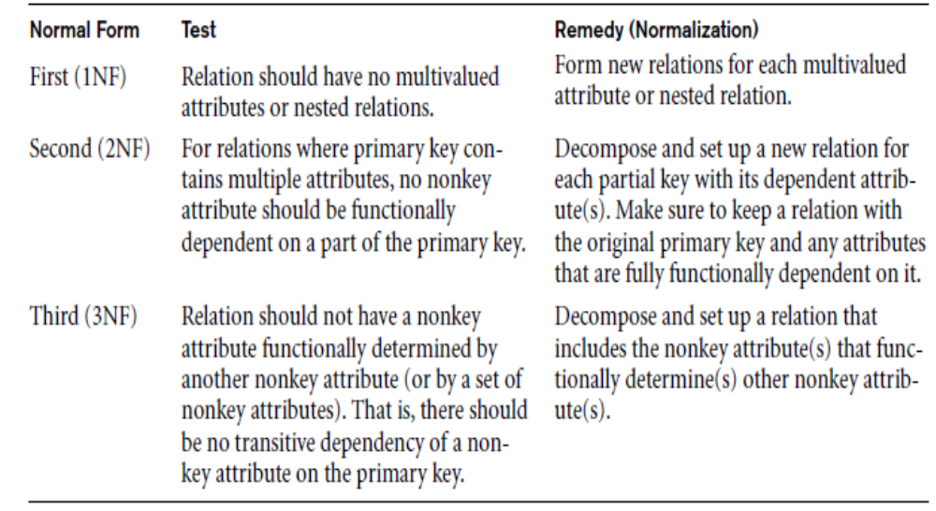
Normalization

Slide 30
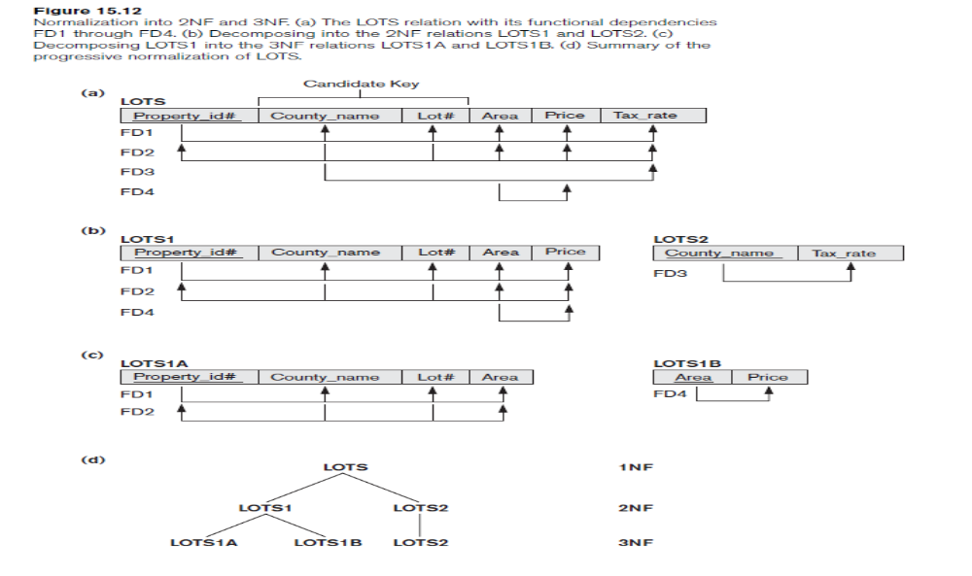
Example
Consider the relation schema LOTS, which describes parcels of land for sale in various counties of a state.
Suppose that there are two candidate keys: Property_id# and {County_name, Lot#}; that is, lot numbers are unique only within each county, but Property_id# numbers are unique across counties for the entire state.
Based on the two candidate keys Property_id# and {County_name, Lot#}, the functional dependencies FD1 and FD2 hold Also FD3: County_name → Tax_rate , FD4: Area → Price

Slide 31
Example
The LOTS relation schema violates the general definition of 2NF because Tax_rate is partially dependent on the candidate key {County_name, Lot#}, due to FD3. To normalize LOTS into 2NF, we decompose it into the two relations LOTS1 and LOTS2

Slide 32
Example
LOTS2 is in 3NF. However, FD4 in LOTS1 violates 3NF because Area is not a super key and Price is not a prime attribute in LOTS1.
To normalize LOTS1 into 3NF, we decompose it into the relation schemas LOTS1A and LOTS1B. We construct LOTS1A by removing the attribute Price that violates 3NF from LOTS1 and placing it with Area into another relation LOTS1B. Both LOTS1A and LOTS1B are in 3NF.

Slide 33
Example

Slide 34
Boyce-Codd Normal Form
A relation schema R is in BCNF if whenever a nontrivial functional dependency X→A holds in R, then X is a super key of R.
In the LOTS relation schema with its four functional dependencies FD1 through FD4. Suppose that we have thousands of lots in the relation but the lots are from only two counties: DeKalb and Fulton.
Suppose also that lot sizes in DeKalb County are only 0.5, 0.6, 0.7, 0.8, 0.9, and 1.0 acres, whereas lot sizes in Fulton County are restricted to 1.1, 1.2, ..., 1.9, and 2.0 acres.
we would then have a additional functional dependency
FD5: Area→County_name.

Slide 35
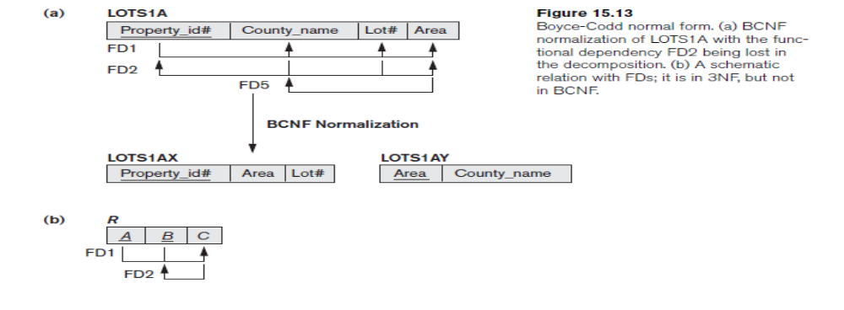
Boyce-Codd Normal Form
If we add this to the other dependencies, the relation schema LOTS1A still is in 3NF because County_name is a prime attribute
FD5, can be represented by 16 tuples in a separate relation R (Area, County_name)
FD5 violates BCNF in LOTS1A because AREA is not a superkey of LOTS1A
FD5 satisfies 3NF in LOTS1A because County_name is a prime attribute

Slide 36
Boyce-Codd Normal Form
We can decompose LOTS1A into two BCNF relations LOTS1AX and LOTS1AY

Slide 37
Contents
Multivalued Attribute
Fourth Normal Form(4NF)
Join Dependency
Fifth Normal Form(5NF)

Slide 38
Multivalued Dependency
A multivalued dependency X→→Y specified on relation schema R, where X and Y are both subsets of R, specifies the following constraint on any relation state r of R: If two tuples t1 and t2 exist in r such that t1[X] = t2[X], then two tuples t3 and t4 should also exist in r with the following properties, where we use Z to denote (R – (X ∪ Y)):
■ t3[X] = t4[X] = t1[X] = t2[X].
■ t3[Y] = t1[Y] and t4[Y] = t2[Y].
■ t3[Z] = t2[Z] and t4[Z] = t1[Z].

Slide 39
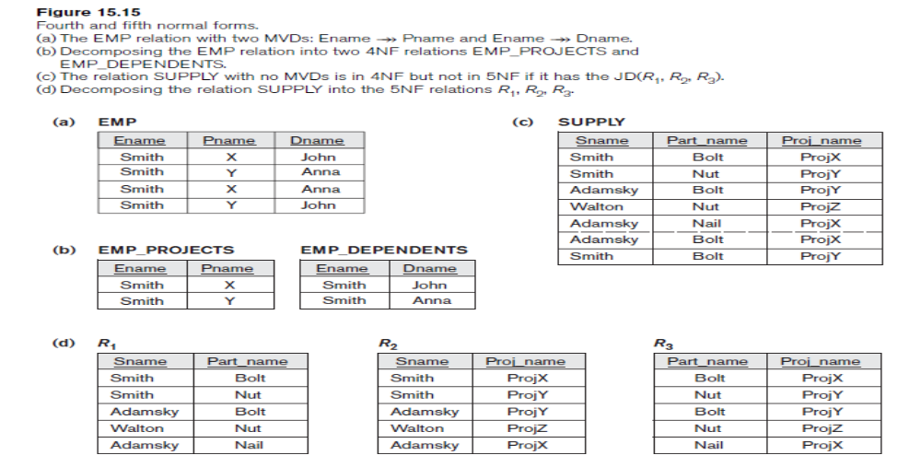
Multivalued Dependency
Whenever X→→Y holds, we say that X multi determines Y. Because of the symmetry in the definition, whenever X →→ Y holds in R, so does X →→ Z. Hence, X →→ Y implies X→→Z, and therefore it is sometimes written as X→→Y|Z.
An MVD X →→ Y in R is called a trivial MVD if (a) Y is a subset of X, or (b) X ∪ Y = R.
An MVD that satisfies neither (a) nor (b) is called a nontrivial MVD.
For example, the relation EMP_PROJECTS has the trivial MVD Ename →→ Pname

Slide 40
Multivalued Dependency
If we have a nontrivial MVD in a relation, we may have to repeat values redundantly in the tuples. In the EMP relation, the values ‘X’ and ‘Y’ of Pname are repeated with each value of Dname (or, by symmetry, the values ‘John’ and ‘Anna’ of Dname are repeated with each value of Pname).
This redundancy is clearly undesirable. Fourth normal form (4NF) is violated when a relation has undesirable multivalued dependencies, and hence can be used to identify and decompose such relations.

Slide 41
Fourth Normal Form(4NF)
A relation schema R is in 4NF with respect to a set of dependencies F (that includes functional dependencies and multivalued dependencies) if, for every nontrivial multivalued dependency X →→ Y in F+ X is a super key for R.
We can state the following points:
■ An all-key relation is always in BCNF since it has no FDs.
■ An all-key relation such as the EMP relation, which has no FDs but has the MVD
Ename →→ Pname | Dname, is not in 4NF.
■ A relation that is not in 4NF due to a nontrivial MVD must be decomposed to convert it into a set of relations in 4NF.
■ The decomposition removes the redundancy caused by the MVD.

Slide 42
Fourth Normal Form(4NF)
Consider the EMP relation.
EMP is not in 4NF because in the nontrivial MVDs Ename→→ Pname and Ename →→ Dname, and Ename is not a super key of EMP.
Decompose EMP into EMP_PROJECTS and EMP_DEPENDENTS.
Both EMP_PROJECTS and EMP_DEPENDENTS are in 4NF, because the MVDs Ename →→ Pname in EMP_PROJECTS and Ename →→ Dname in EMP_DEPENDENTS are trivial MVDs.
No other nontrivial MVDs hold in either EMP_PROJECTS or EMP_DEPENDENTS. No FDs hold in these relation schemas either.

Slide 43
Join Dependencies
A join dependency (JD), denoted by JD (R1, R2, ..., Rn), specified on relation schema R, specifies a constraint on the states r of R. The constraint states that every legal state r of R should have a non additive join decomposition into R1, R2, ..., Rn. Hence, for every such r we have
∗ (πR1 (r), πR2 (r), ..., πRn (r)) = r
MVD is a special case of a JD where n = 2.
That is, a JD denoted as JD (R1, R2) implies an MVD
(R1 ∩ R2) →→ (R1 – R2)
(or, by symmetry, (R1 ∩ R2) →→ (R2 – R1)).

Slide 44
Fifth normal form (5NF)
A relation schema R is in fifth normal form (5NF) (or project-join normal form (PJNF)) with respect to a set F of functional, multivalued, and join dependencies if, for every nontrivial join dependency JD (R1, R2, … , Rn) in F+ (that is, implied by F), every Ri is a super key of R

Slide 45
Fifth normal form (5NF)
For an example of a JD, consider once again the SUPPLY all-key relation in Figure (c). Suppose that the following additional constraint always holds:
Whenever a supplier s supplies part p, and a project j uses part p, and the supplier s supplies at least one part to project j, then supplier s will also be supplying part p to project j.

Slide 46
Fifth normal form (5NF)
This constraint can be restated in other ways and specifies a join dependency
JD (R1, R2, R3) among the three projections
R1 (Sname, Part_name),
R2 (Sname, Proj_name), and
R3 (Part_name, Proj_name) of SUPPLY
SUPPLY relation with the join dependency is decomposed into three relations R1, R2, and R3 that are each in 5NF.
Notice that applying a natural join to any two of these relations produces spurious tuples, but applying a natural join to all three together does not.

Slide 47
Thank
You

